Slide 1
Introduction to Recursion
©1992-2017 by Pearson Education, Inc. All Rights Reserved.

Slide 2
6.18 Recursion
A recursive function is a function that calls itself, either directly, or indirectly (through another function).
Recursive problem-solving approaches have a number of elements in common.
A recursive function is called to solve a problem.
The function actually knows how to solve only the simplest case(s), or so-called base case(s).
If the function is called with a base case, the function simply returns a result.
If the function is called with a more complex problem, it typically divides the problem into two conceptual pieces—a piece that the function knows how to do and a piece that it does not know how to do.
This new problem looks like the original, so the function calls a copy of itself to work on the smaller problem—this is referred to as a recursive call and is also called the recursion step.
©1992-2017 by Pearson Education, Inc. All Rights Reserved.

Slide 3
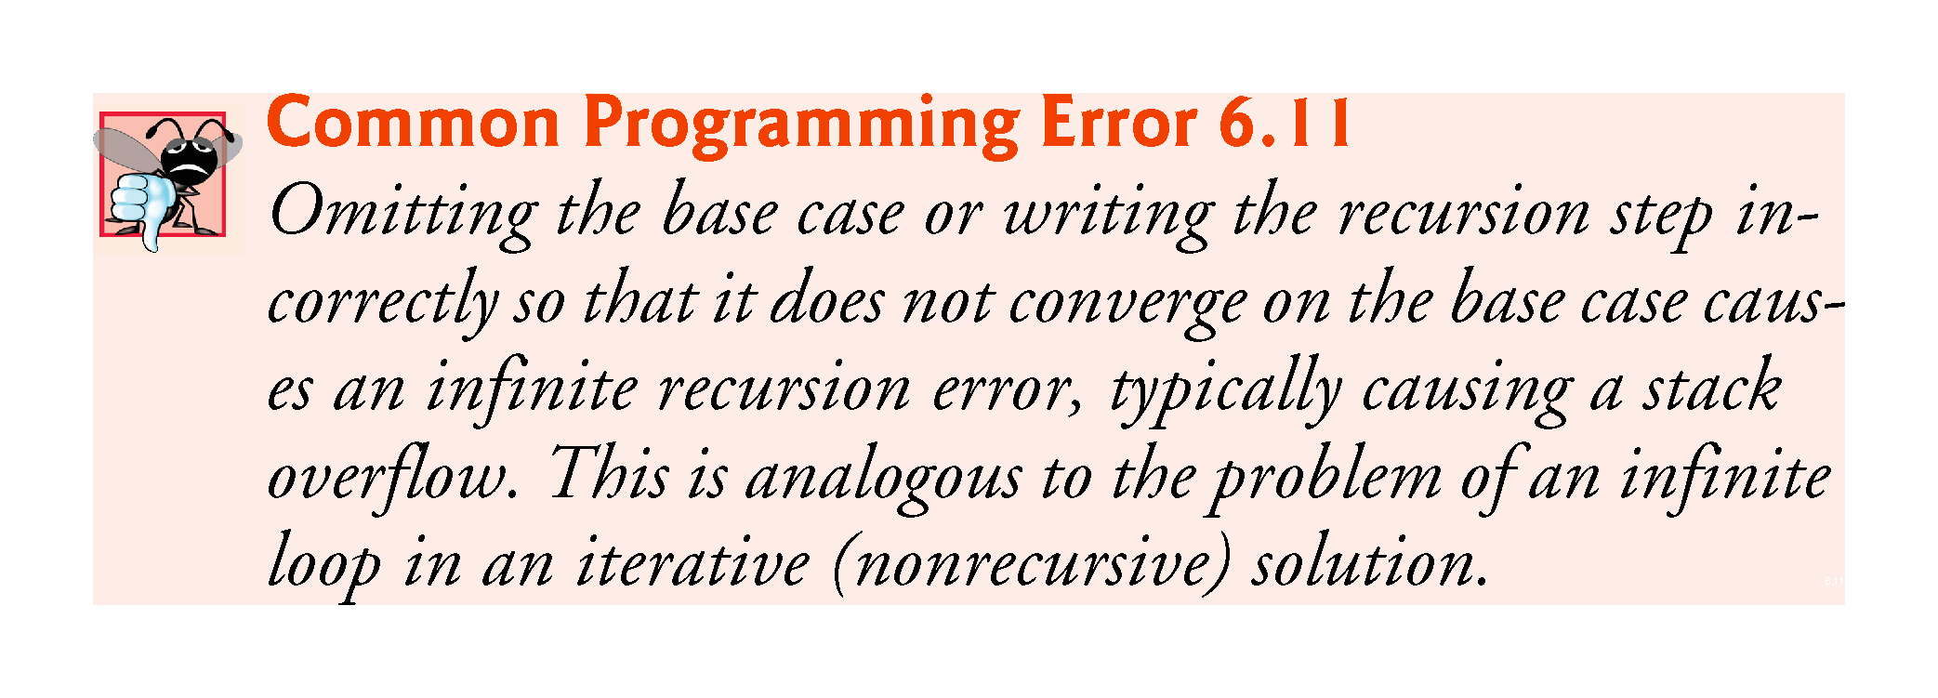
©1992-2017 by Pearson Education, Inc. All Rights Reserved.

Slide 4
6.18 Recursion (cont.)
The recursion step often includes the key-word return, because its result will be combined with the portion of the problem the function knew how to solve to form the result passed back to the original caller, possibly main.
The recursion step executes while the original call to the function is still “open,” i.e., it has not yet finished executing.
The recursion step can result in many more such recursive calls.
©1992-2017 by Pearson Education, Inc. All Rights Reserved.

Slide 5
Recursive Methods Must Eventually Terminate
A recursive method must have
at least one base, or stopping, case.
A base case does not execute a recursive call
stops the recursion
Each successive call to itself must be a "smaller version of itself”
an argument that describes a smaller problem
a base case is eventually reached

Slide 6
Key Components of a Recursive Algorithm Design
What is a smaller identical problem(s)?
Decomposition
How are the answers to smaller problems combined to form the answer to the larger problem?
Composition
Which is the smallest problem that can be solved easily (without further decomposition)?
Base/stopping case

Slide 7
6.18 Recursion (cont.)
Factorial
The factorial of a nonnegative integer n, written n! (and pronounced “n factorial”), is the product
n · (n – 1) · (n – 2) · … · 1
with 1! equal to 1, and 0! defined to be 1.
©1992-2017 by Pearson Education, Inc. All Rights Reserved.

Slide 8
6.18 Recursion (cont.)
Iterative Factorial
The factorial of an integer, number, greater than or equal to 0, can be calculated iteratively (nonrecursively) by using a loop.
Recursive Factorial
A recursive definition of the factorial function is arrived at by observing the following algebraic relationship:
n! = n · (n – 1)!
©1992-2017 by Pearson Education, Inc. All Rights Reserved.

Slide 9
6.18 Recursion (cont.)
Evaluating 5!
The evaluation of 5! would proceed as shown in Fig. 6.24, which illustrates how the succession of recursive calls proceeds until 1! is evaluated to be 1, terminating the recursion.
Figure 6.24(b) shows the values returned from each recursive call to its caller until the final value is calculated and returned.
©1992-2017 by Pearson Education, Inc. All Rights Reserved.

Slide 10
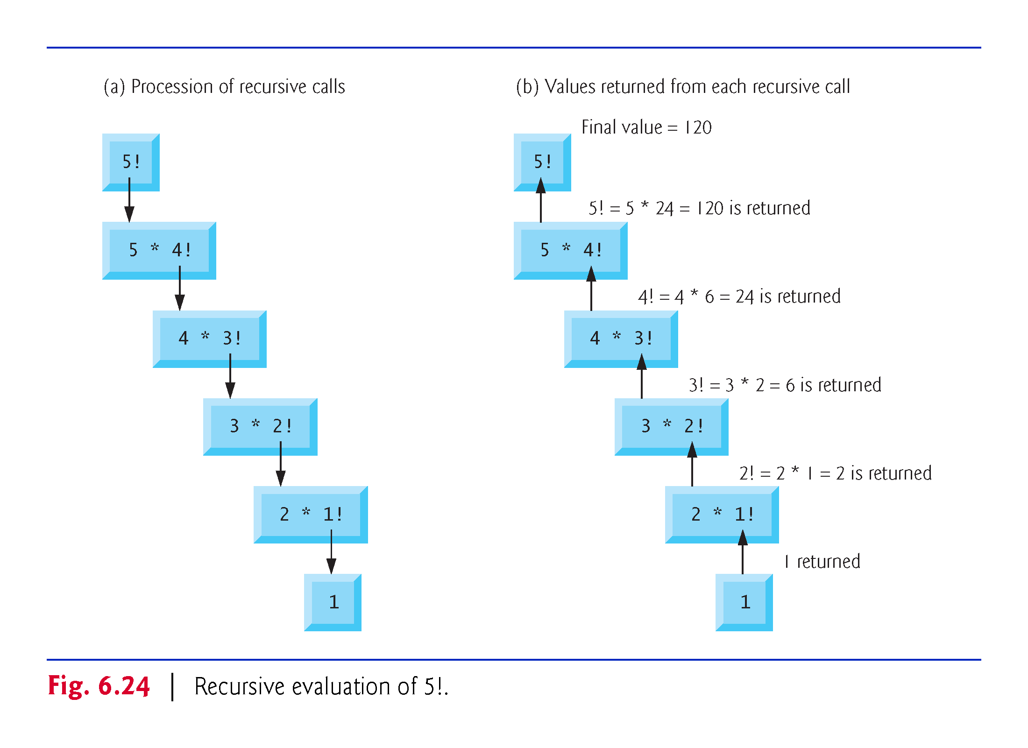
©1992-2017 by Pearson Education, Inc. All Rights Reserved.

Slide 11
Factorial (N!)
N! = (N-1)! * N [for N > 1]
1! = 1
3!
= 2! * 3
= (1! * 2) * 3
= 1 * 2 * 3
Recursive design:
Decomposition: (N-1)!
Composition: * N
Base case: 1!

Slide 12
6.18 Recursion (cont.)
Using a Recursive factorial Function to Calculate Factorials
Figure 6.25 uses recursion to calculate and print the factorials of the integers 0–10.
©1992-2017 by Pearson Education, Inc. All Rights Reserved.

Slide 13
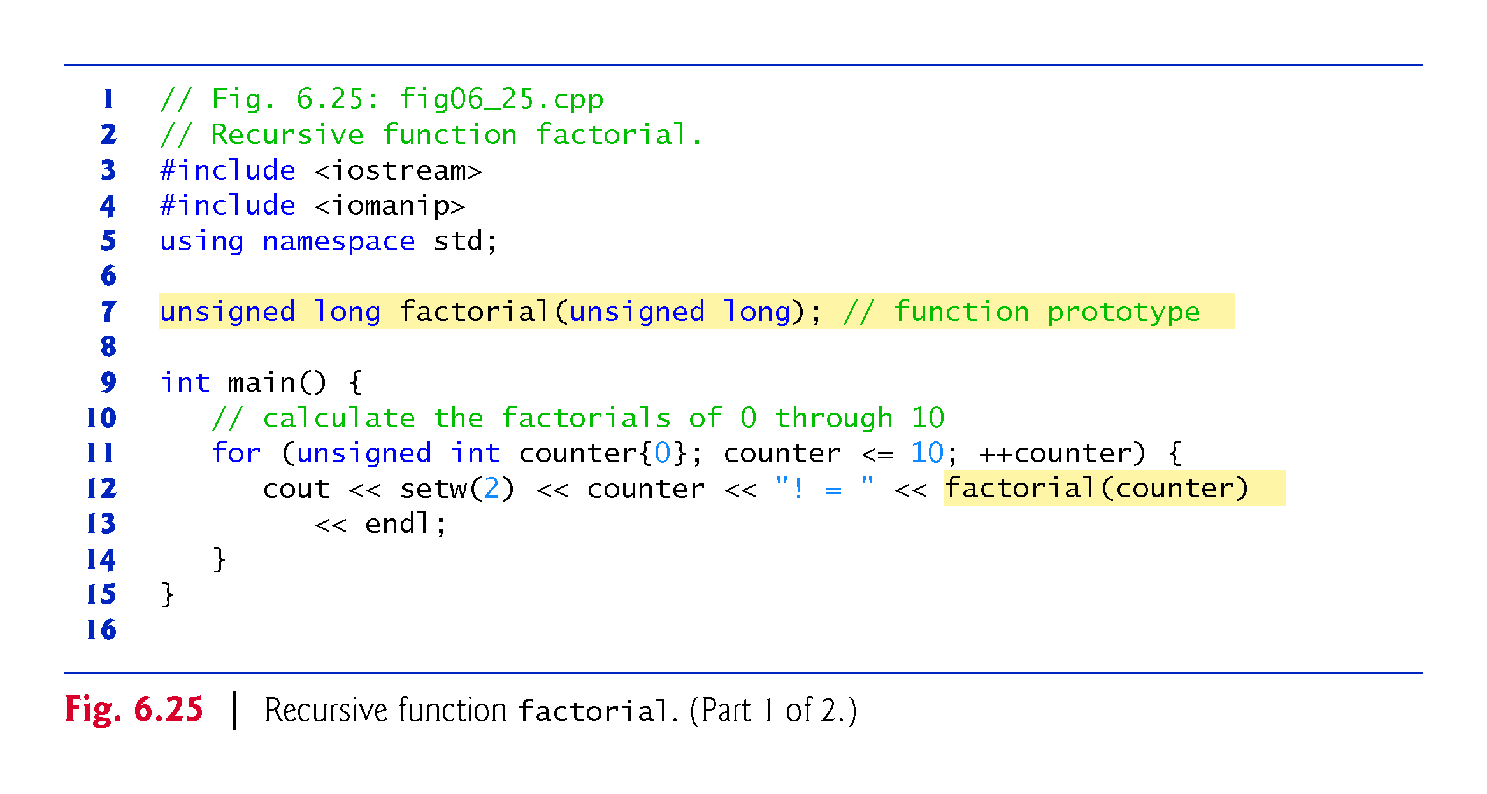
©1992-2017 by Pearson Education, Inc. All Rights Reserved.

Slide 14
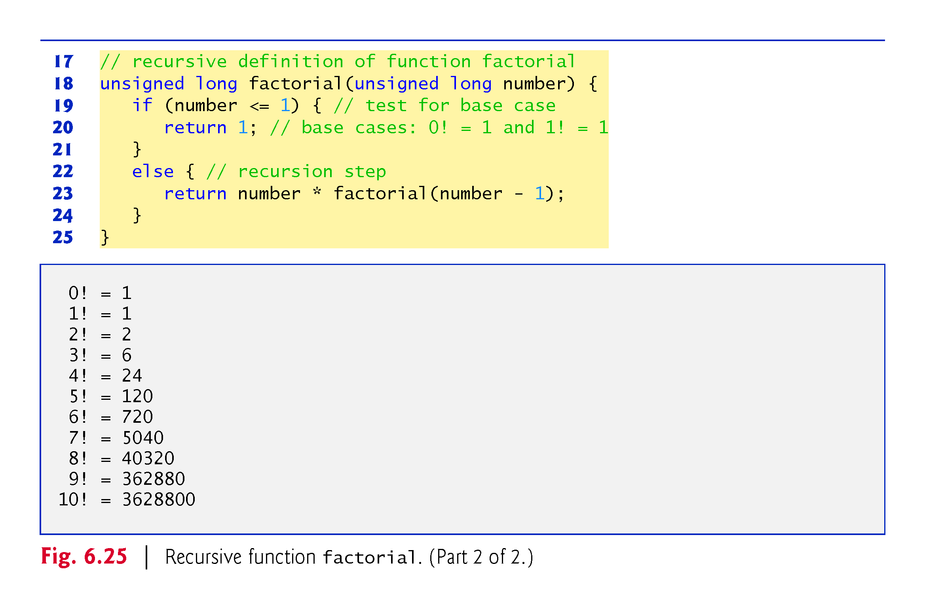
©1992-2017 by Pearson Education, Inc. All Rights Reserved.

Slide 15
6.18 Recursion (cont.)
C++11 Type unsigned long long int
C++11’s unsigned long long int type (which can be abbreviated as unsigned long long ) on some systems enables you to store values in at least 8 bytes (64 bits) which can hold numbers as large as 18,446,744,073,709,551,615.
©1992-2017 by Pearson Education, Inc. All Rights Reserved.

Slide 16
factorial Method
long factorial(long n)
{
long fact;
if (n > 1) // recursive case (decomposition)
fact = factorial(n – 1) * n; // composition
else // base case
fact = 1;
return fact;
}

Slide 17
long factorial(long 3)
{
long fact;
if (n > 1)
fact = factorial(2) * 3;
else
fact = 1;
return fact;
}

Slide 18
long factorial(long 3)
{
int fact;
if (n > 1)
fact = factorial(2) * 3;
else
fact = 1;
return fact;
}
long factorial(long 2)
{
long fact;
if (n > 1)
fact = factorial(1) * 2;
else
fact = 1;
return fact;
}

Slide 19
long factorial(long 3)
{
int fact;
if (n > 1)
fact = factorial(2) * 3;
else
fact = 1;
return fact;
}
long factorial(long 2)
{
int fact;
if (n > 1)
fact = factorial(1) * 2;
else
fact = 1;
return fact;
}
long factorial(long 1)
{
long fact;
if (n > 1)
fact = factorial(n - 1) * n;
else
fact = 1;
return fact;
}

Slide 20
long factorial(long 3)
{
long fact;
if (n > 1)
fact = factorial(2) * 3;
else
fact = 1;
return fact;
}
long factorial(long 2)
{
long fact;
if (n > 1)
fact = factorial(1) * 2;
else
fact = 1;
return fact;
}
long factorial(long 1)
{
long fact;
if (n > 1)
fact = factorial(n - 1) * n;
else
fact = 1;
return 1;
}

Slide 21
Long factorial(long 3)
{
long fact;
if (n > 1)
fact = factorial(2) * 3;
else
fact = 1;
return fact;
}
Long factorial(long 2)
{
long fact;
if (n > 1)
fact = 1 * 2;
else
fact = 1;
return fact;
}
long factorial(long 1)
{
long fact;
if (n > 1)
fact = factorial(n - 1) * n;
else
fact = 1;
return 1;
}

Slide 22
long factorial(long 3)
{
long fact;
if (n > 1)
fact = factorial(2) * 3;
else
fact = 1;
return fact;
}
long factorial(long 2)
{
long fact;
if (n > 1)
fact = 1 * 2;
else
fact = 1;
return 2;
}

Slide 23
long factorial(long 3)
{
long fact;
if (n > 1)
fact = 2 * 3;
else
fact = 1;
return fact;
}
long factorial(long 2)
{
long fact;
if (n > 1)
fact = 1 * 2;
else
fact = 1;
return 2;
}

Slide 24
long factorial(long 3)
{
long fact;
if (n > 1)
fact = 2 * 3;
else
fact = 1;
return 6;
}

Slide 25
Execution Trace (decomposition)
long factorial(long n)
{
long fact;
if (n > 1) // recursive case (decomposition)
fact = factorial(n – 1) * n; (composition)
else // base case
fact = 1;
return fact;
}
factorial(4)
factorial(3) 4

Slide 26
Execution Trace (decomposition)
long factorial(long n)
{
long fact;
if (n > 1) // recursive case (decomposition)
fact = factorial(n – 1) * n; (composition)
else // base case
fact = 1;
return fact;
}
factorial(4)
factorial(3) 4
factorial(2) 3

Slide 27
Execution Trace (decomposition)
long factorial(long n)
{
long fact;
if (n > 1) // recursive case (decomposition)
fact = factorial(n – 1) * n; (composition)
else // base case
fact = 1;
return fact;
}
factorial(4)
factorial(3) 4
factorial(2) 3
factorial(1) 2

Slide 28
Execution Trace (composition)
Long factorial(long n)
{
long fact;
if (n > 1) // recursive case (decomposition)
fact = factorial(n – 1) * n; (composition)
else // base case
fact = 1;
return fact;
}
factorial(4)
*
factorial(3) 4
*
factorial(2) 3
*
factorial(1)->1 2

Slide 29
Execution Trace (composition)
long factorial(long n)
{
long fact;
if (n > 1) // recursive case (decomposition)
fact = factorial(n – 1) * n; (composition)
else // base case
fact = 1;
return fact;
}
factorial(4)
*
factorial(3) 4
*
factorial(2)->2 3

Slide 30
Execution Trace (composition)
long factorial(long n)
{
long fact;
if (n > 1) // recursive case (decomposition)
fact = factorial(n – 1) * n; (composition)
else // base case
fact = 1;
return fact;
}
factorial(4)
*
factorial(3)->6 4

Slide 31
Execution Trace (composition)
long factorial(long n)
{
long fact;
if (n > 1) // recursive case (decomposition)
fact = factorial(n – 1) * n; (composition)
else // base case
fact = 1;
return fact;
}
factorial(4)->24

Slide 32
6.19 Example Using Recursion: Fibonacci Series
The Fibonacci series
0, 1, 1, 2, 3, 5, 8, 13, 21, …
begins with 0 and 1 and has the property that each subsequent Fibonacci number is the sum of the previous two Fibonacci numbers.
The series occurs in nature and, in particular, describes a form of spiral.
The ratio of successive Fibonacci numbers converges on a constant value of 1.618….
This frequently occurs in nature and has been called the golden ratio or the golden mean.
Humans tend to find the golden mean aesthetically pleasing.
©1992-2017 by Pearson Education, Inc. All Rights Reserved.

Slide 33
6.19 Example Using Recursion: Fibonacci Series (cont.)
Recursive Fibonacci Definition
The Fibonacci series can be defined recursively as follows:
fibonacci(0) = 0 fibonacci(1) = 1 fibonacci(n) = fibonacci(n – 1) + fibonacci(n – 2)
The program of Fig. 6.26 calculates the nth Fibonacci number recursively by using function fibonacci.
©1992-2017 by Pearson Education, Inc. All Rights Reserved.

Slide 34
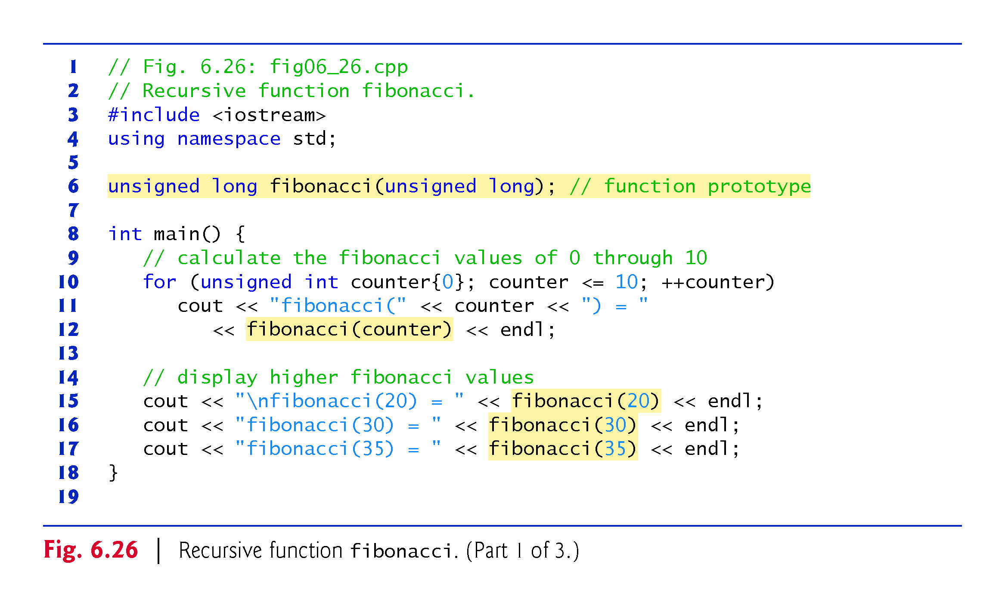
©1992-2017 by Pearson Education, Inc. All Rights Reserved.

Slide 35
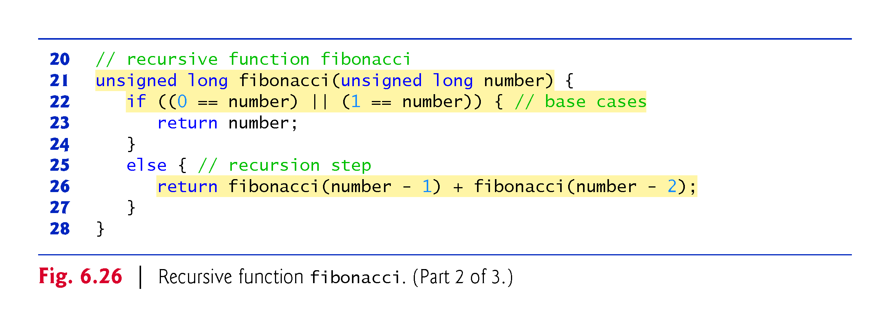
©1992-2017 by Pearson Education, Inc. All Rights Reserved.

Slide 36
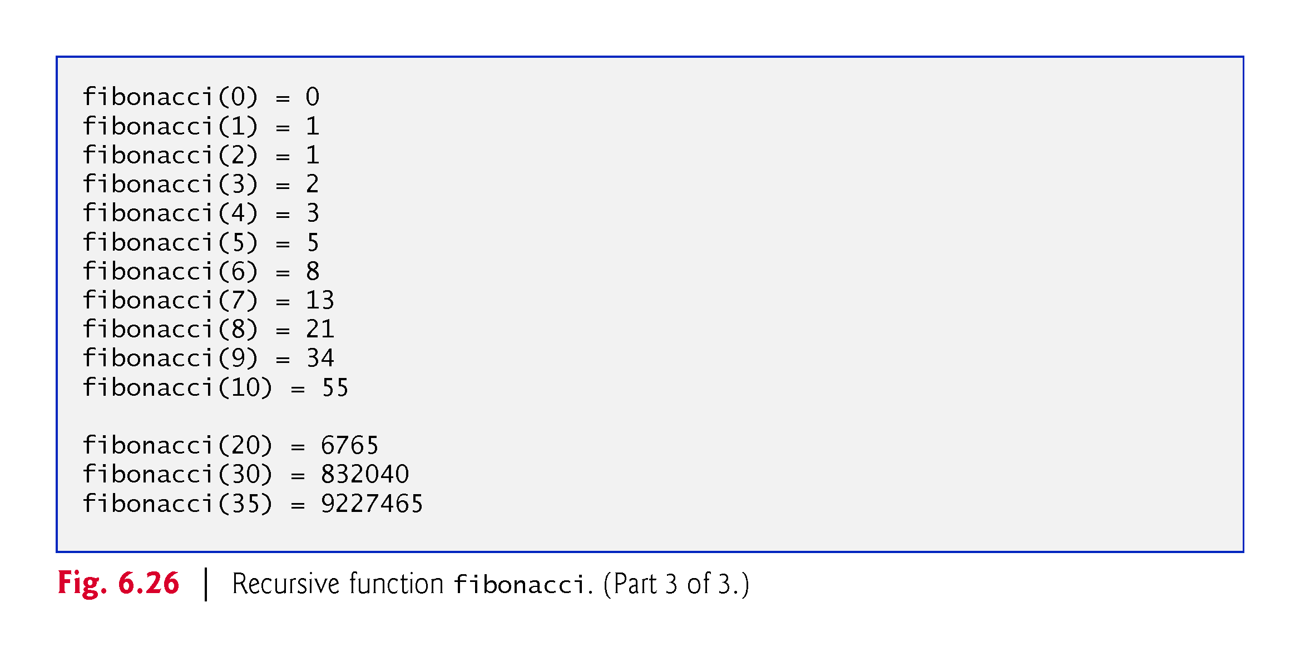
©1992-2017 by Pearson Education, Inc. All Rights Reserved.

Slide 37
6.19 Example Using Recursion: Fibonacci Series (cont.)
Figure 6.27 shows how function fibonacci would evaluate fibonacci(3).
Figure raises interesting issues about the order in which C++ compilers evaluate the operands of operators.
Separate issue from the order in which operators are applied to their operands, namely, the order dictated by the rules of operator precedence and associativity.
Most programmers assume that operands are evaluated left to right.
C++ does not specify the order in which the operands of most operators (including +) are to be evaluated.
Therefore, you must make no assumption about the order in which these calls execute.
©1992-2017 by Pearson Education, Inc. All Rights Reserved.

Slide 38
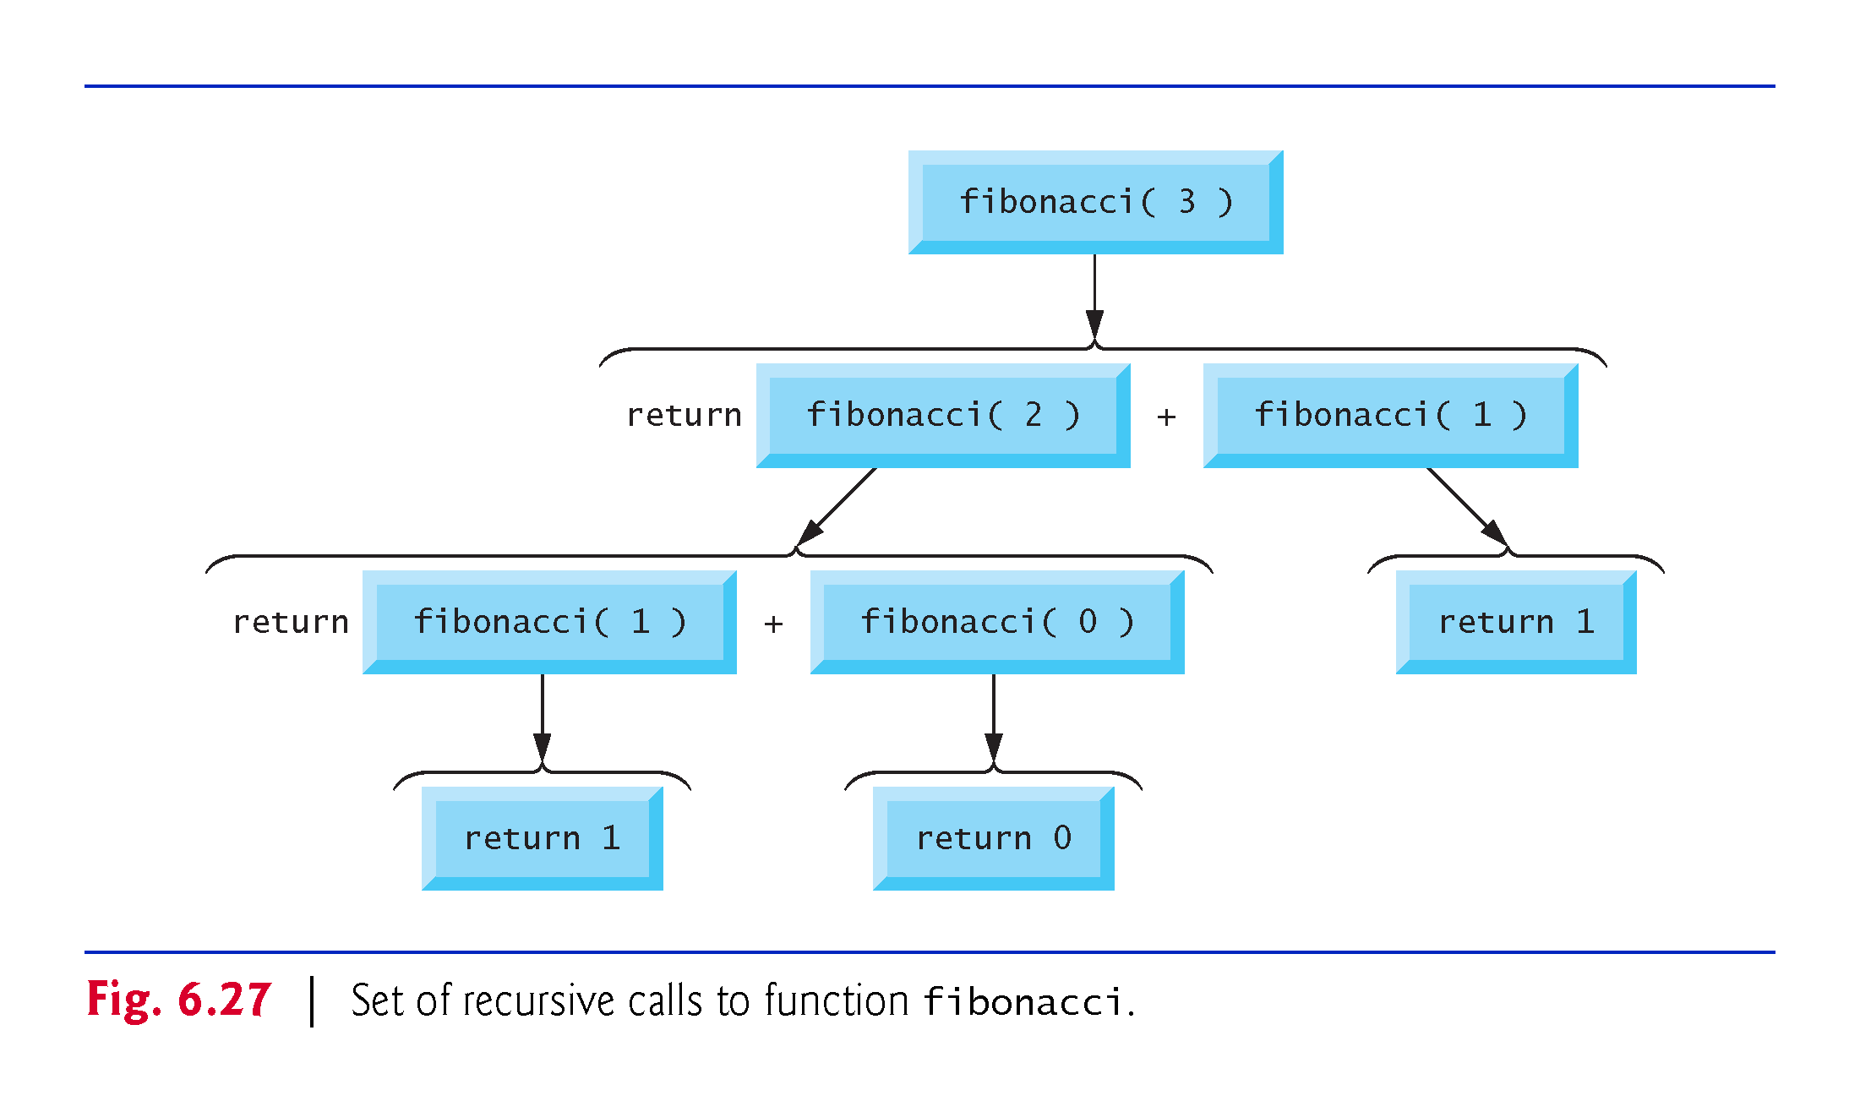
©1992-2017 by Pearson Education, Inc. All Rights Reserved.

Slide 39
Execution Trace (decomposition)
fibonacci(4)
fibonacci(3)
fibonacci(2)

Slide 40
Execution Trace (decomposition)
fibonacci(4)
fibonacci(3)
fibonacci(2)
fibonacci(2)
fibonacci(1)

Slide 41
Execution Trace (composition)
fibonacci(4)
+
fibonacci(3)
fibonacci(2)
+
fibonacci(2)->1
fibonacci(1)->0

Slide 42
Execution Trace (composition)
fibonacci(4)
+
fibonacci(3)->1
fibonacci(2)->1

Slide 43
Execution Trace (composition)
fibonacci(4)->2

Slide 44
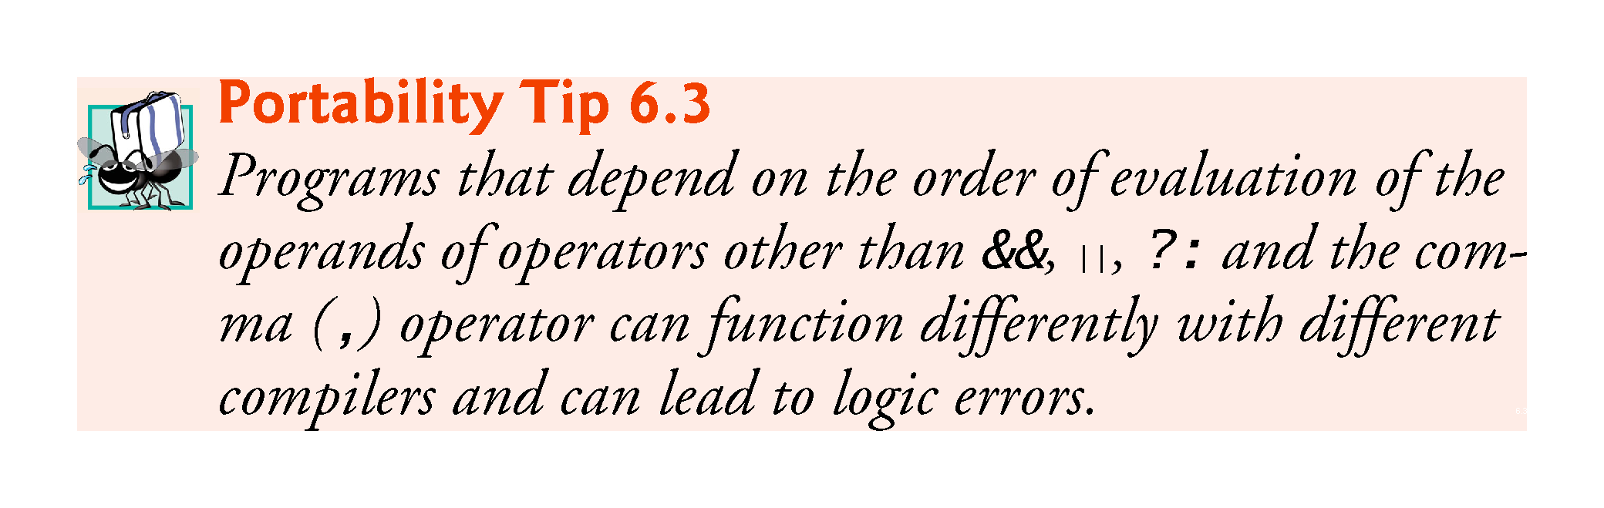
©1992-2017 by Pearson Education, Inc. All Rights Reserved.

Slide 45
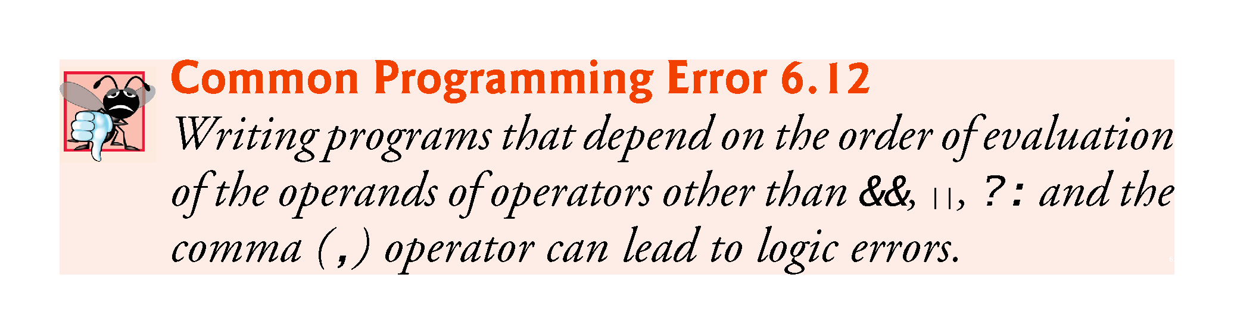
©1992-2017 by Pearson Education, Inc. All Rights Reserved.

Slide 46
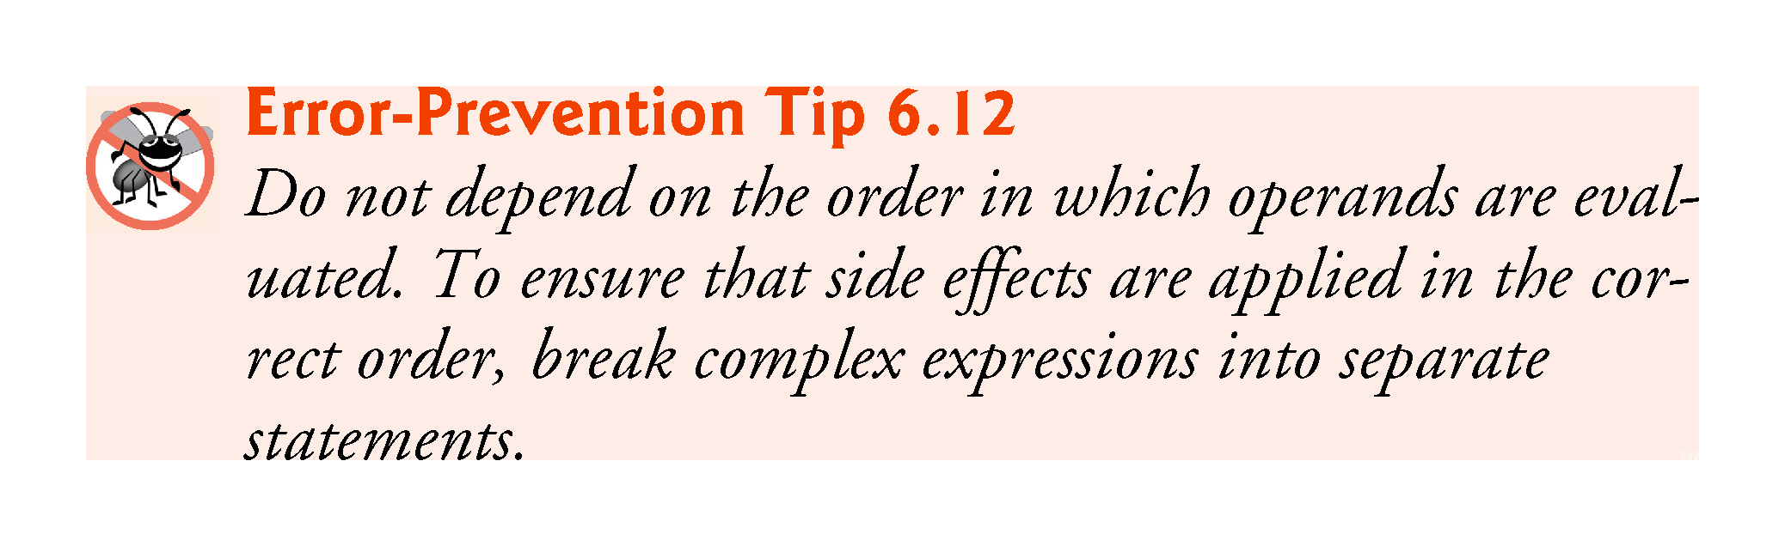
©1992-2017 by Pearson Education, Inc. All Rights Reserved.

Slide 47
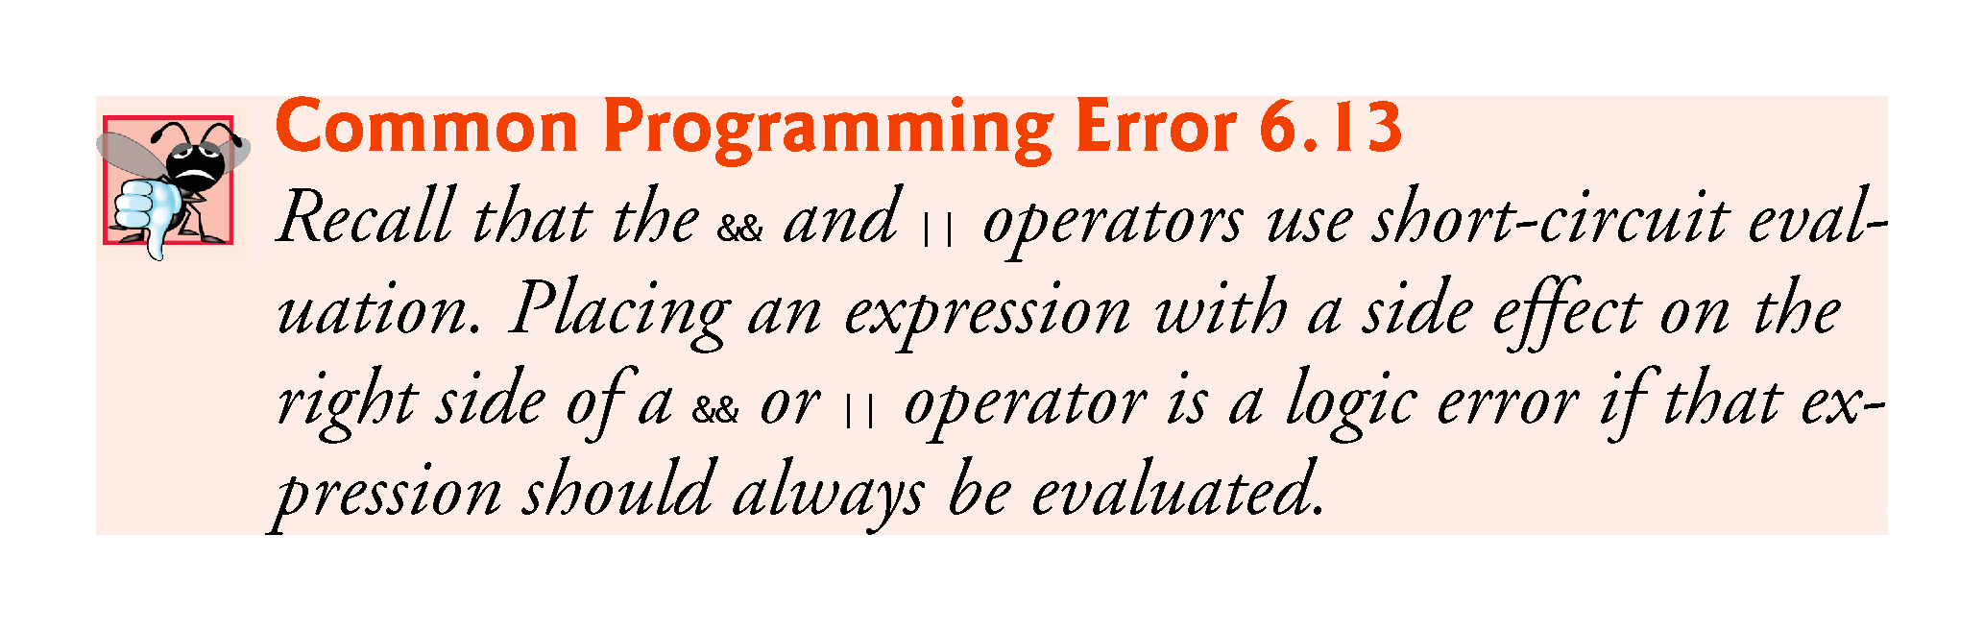
©1992-2017 by Pearson Education, Inc. All Rights Reserved.

Slide 48
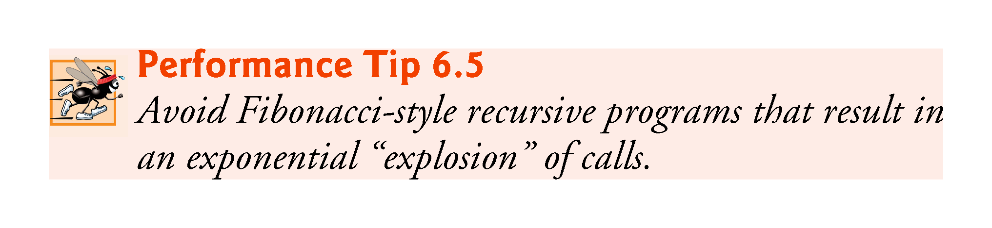
©1992-2017 by Pearson Education, Inc. All Rights Reserved.

Slide 49
6.20 Recursion vs. Iteration
Both iteration and recursion are based on a control statement:
Iteration uses an iteration statement
Recursion uses a selection statement.
Both iteration and recursion involve iteration:
Iteration explicitly uses an iteration statement
Recursion achieves repetition through repeated function calls.
Iteration and recursion each involve a termination test:
Iteration terminates when the loop-continuation condition fails
Recursion terminates when a base case is recognized.
©1992-2017 by Pearson Education, Inc. All Rights Reserved.

Slide 50
6.22 Recursion vs. Iteration (cont.)
Counter-controlled iteration and recursion both gradually approach termination:
Iteration modifies a counter until the counter assumes a value that makes the loop-continuation condition fail
Recursion produces simpler versions of the original problem until the base case is reached.
Both iteration and recursion can occur infinitely:
An infinite loop occurs with iteration if the loop-continuation test never becomes false
Infinite recursion occurs if the recursion step does not reduce the problem during each recursive call in a manner that converges on the base case.
To illustrate the differences between iteration and recursion, Fig. 6.28 presents an iterative solution to the factorial problem.
©1992-2017 by Pearson Education, Inc. All Rights Reserved.

Slide 51
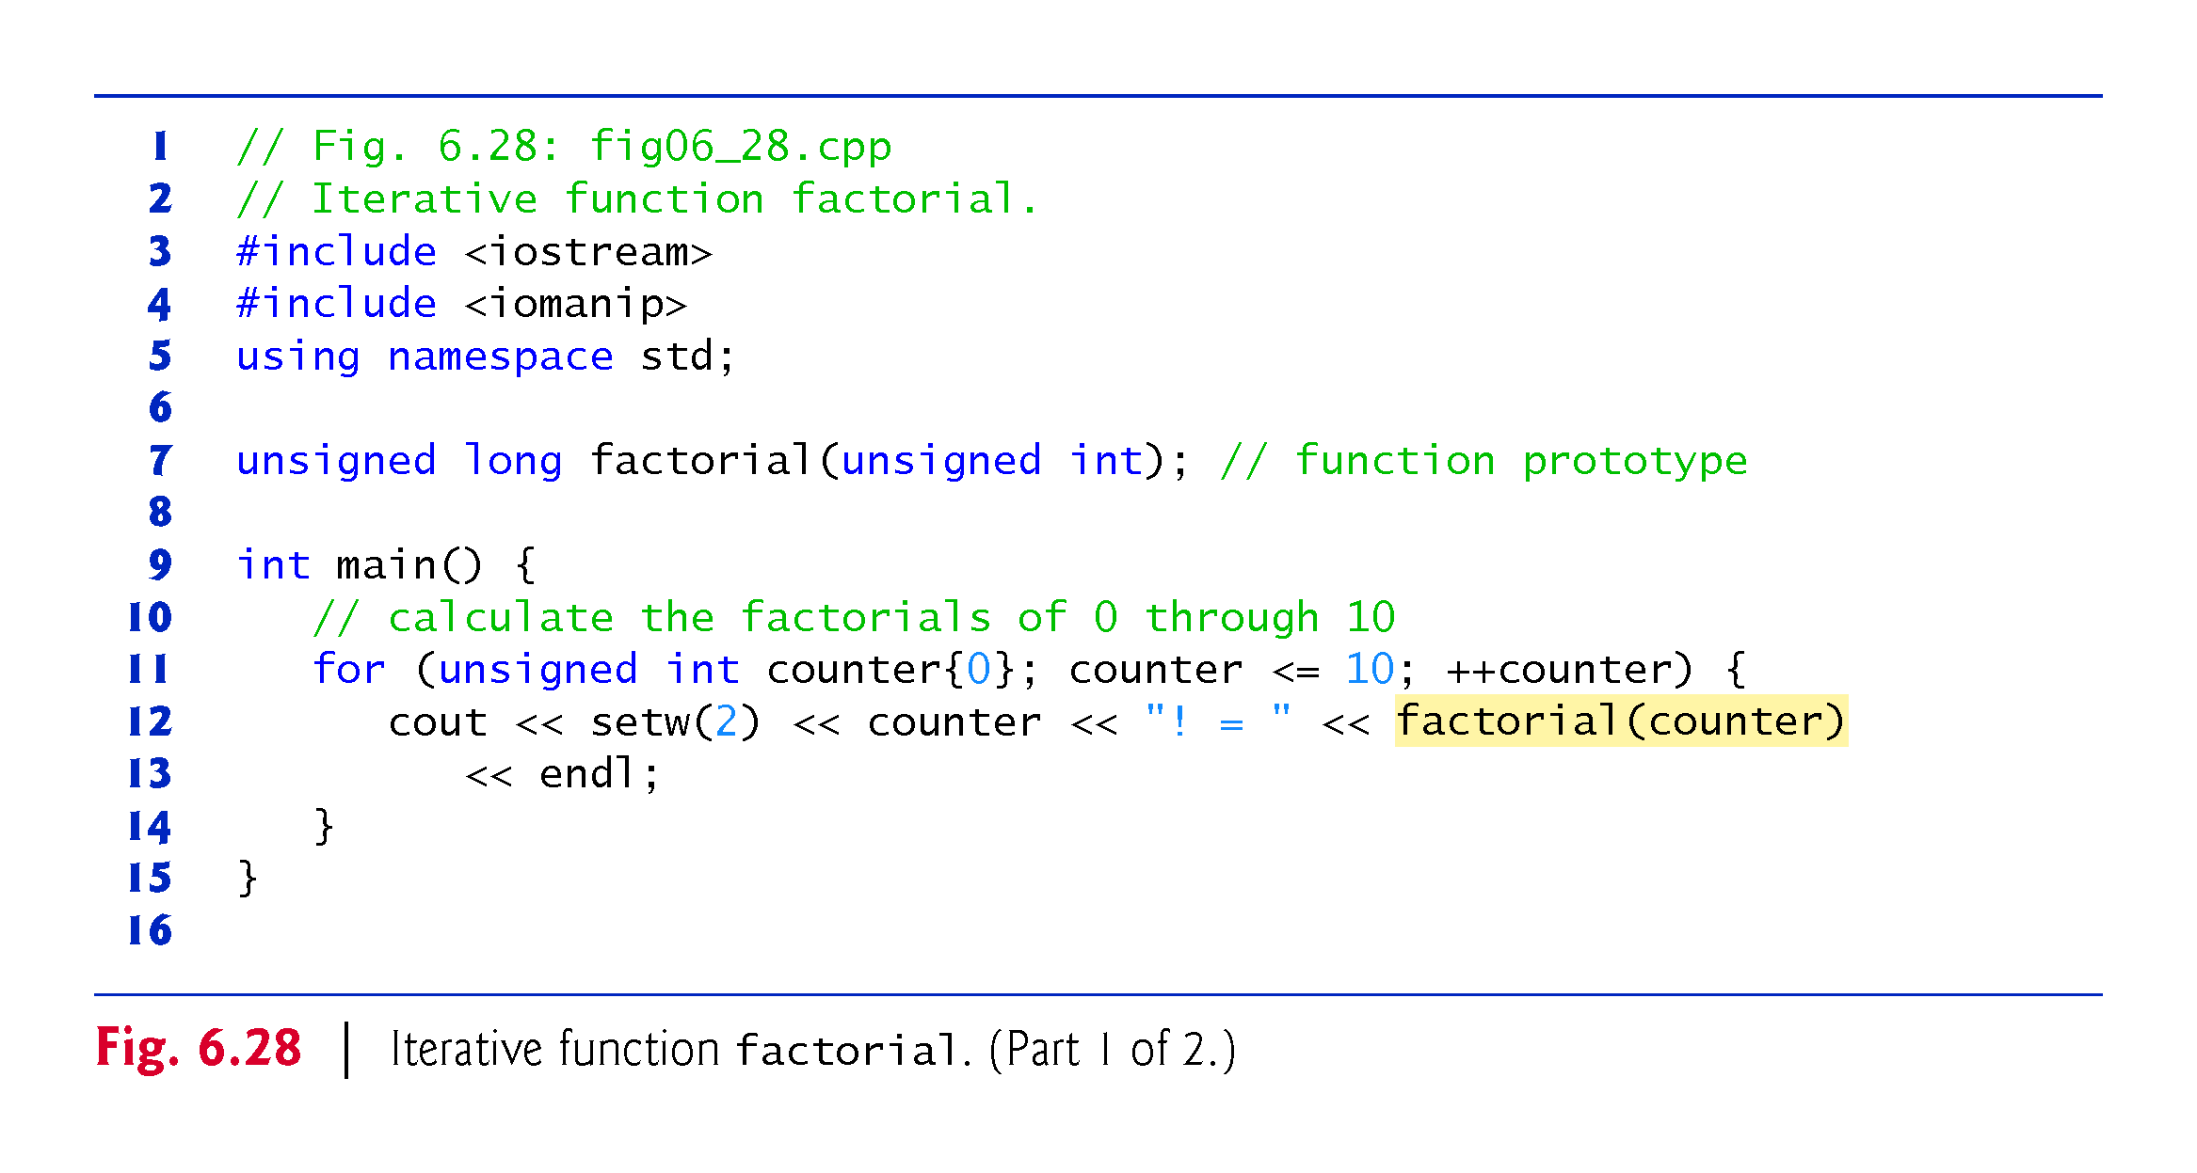
©1992-2017 by Pearson Education, Inc. All Rights Reserved.

Slide 52
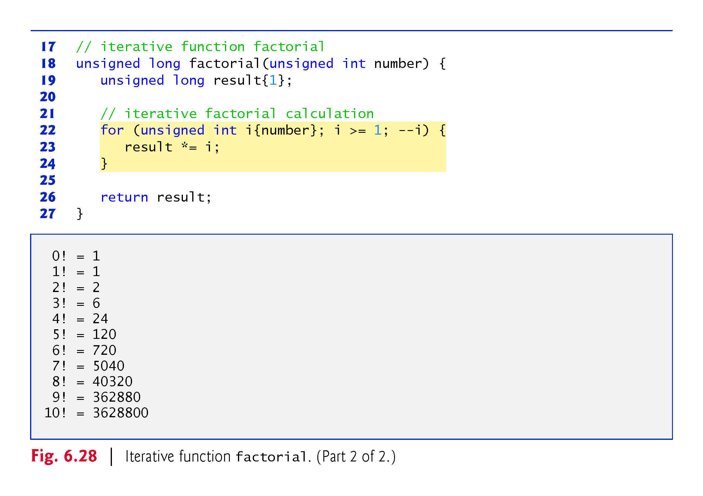
©1992-2017 by Pearson Education, Inc. All Rights Reserved.

Slide 53
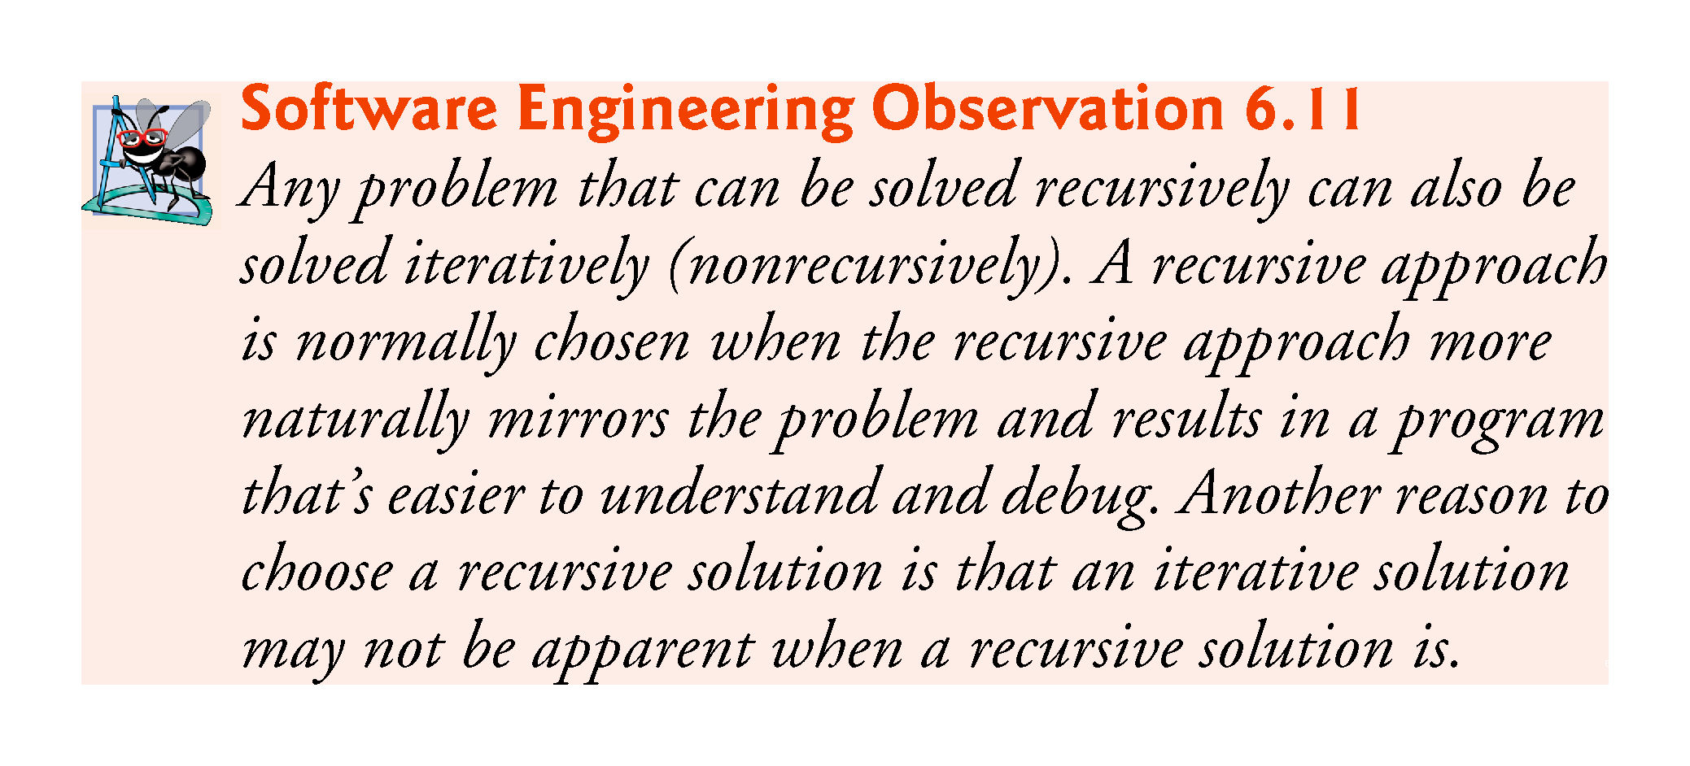
©1992-2017 by Pearson Education, Inc. All Rights Reserved.

Slide 54
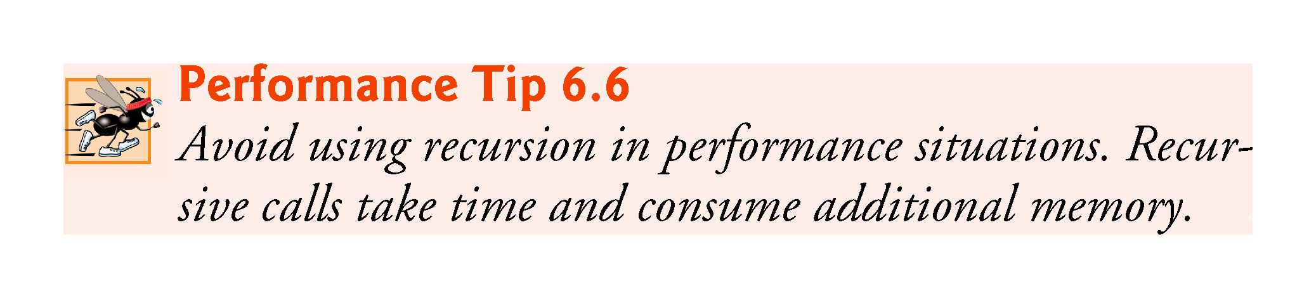
©1992-2017 by Pearson Education, Inc. All Rights Reserved.

Slide 55
Number of Zeros in a Number
Example: 2030 has 2 zeros
If n has two or more digits
the number of zeros is the number of zeros in n with the last digit removed
plus an additional 1 if the last digit is zero
Examples:
number of zeros in 20030 is number of zeros in 2003 plus 1
number of zeros in 20031 is number of zeros in 2003 plus 0
recursive

Slide 56
numberOfZeros Recursive Design
numberOfZeros in the number N
K = number of digits in N
Decomposition:
numberOfZeros in the first K - 1 digits
Last digit
Composition:
Add:
numberOfZeros in the first K - 1digits
1 if the last digit is zero
Base case:
N has one digit (K = 1)

Slide 57
numberOfZeros method
int numberOfZeros(int n)
{
int zeroCount;
if (n==0)
zeroCount = 1;
else if (n < 10) // and not 0
zeroCount = 0; // 0 for no zeros
else if (n%10 == 0)
zeroCount = numberOfZeros(n/10) + 1;
else // n%10 != 0
zeroCount = numberOfZeros(n/10);
return zeroCount;
}
Which is (are) the base case(s)? Why?
Decompostion, Why?
Composition, why?

Slide 58
int numberOfZeros(int n)
{
int zeroCount;
if (n==0)
zeroCount = 1;
else if (n < 10) // and not 0
zeroCount = 0; // 0 for no zeros
else if (n%10 == 0)
zeroCount = numberOfZeros(n/10) + 1;
else // n%10 != 0
zeroCount = numberOfZeros(n/10);
return zeroCount;
}
Execution Trace (decomposition)
Each method invocation will execute one of the if-else cases shown at right.
numberOfZeros(2005)
numberOfZeros(200) 5
numberOfZeros(20) 0
numberOfZeros(2) 0

Slide 59
int numberOfZeros(int n)
{
int zeroCount;
if (n==0)
zeroCount = 1;
else if (n < 10) // and not 0
zeroCount = 0; // 0 for no zeros
else if (n%10 == 0)
zeroCount = numberOfZeros(n/10) + 1;
else // n%10 != 0
zeroCount = numberOfZeros(n/10);
return zeroCount;
}
Execution Trace (composition)
Recursive calls return
numberOfZeros(2005)->2
numberOfZeros(200)->2 5->0
numberOfZeros(20)->1 0->1
numberOfZeros(2)->0 0->1
+
+
+

Slide 60
Number in English Words
Process an integer and print out its digits in words
Input: 123
Output: "one two three”

Slide 61
inWords Resursive Design
inWords prints a number N in English words
K = number of digits in N
Decomposition:
inWords for the first K – 1 digits
Print the last digit
Composition:
Execution order of composed steps [more later]
Base case:
N has one digit (K = 1)

Slide 62
inWords method
Base case executes when only 1 digit is left
Size of problem is reduced for each recursive call

Slide 63
Execution Trace (decomposition)
inwords(987)
inwords(98) [print “seven”]
inwords(9) [print “eight”]
[print “nine”]
No output yet, why?

Slide 64
Execution Trace (composition)
inwords(987)
inwords(98) print “seven”
inwords(9) print “eight”
print “nine”
Output: nine eight seven

Slide 65
What Happens with a Recursive Call
1
inWords(987)
if (987 < 10)
// print digit here
else //two or more digits left
{
inWords(987/10);
// print digit here
}
inWords (slightly simplified) with argument 987

Slide 66
Execution Trace
inWords(987)
if (987 < 10)
// print digit here
else //two or more digits left
{
inWords(987/10);
// print digit here
}
The argument is getting shorter and will eventually get to the base case.
2
inWords(98)
if (98 < 10)
// print digit here
else //two or more digits left
{
inWords(98/10);
// print digit here
}
Computation waits here until recursive call returns
The if condition is false
recursive call to inWords, with 987/10 or 98 as the argument

Slide 67
Execution Trace
inWords(987)
if (987 < 10)
// print digit here
else //two or more digits left
{
inWords(987/10);
// print digit here
}
inWords(98)
if (98 < 10)
// print digit here
else //two or more digits left
{
inWords(98/10);
// print digit here
}
inWords(9)
if (9 < 10)
// print digit here
else //two or more digits left
{
inWords(numeral/10);
// print digit here
}
3
the if condition is false
another recursive call is made.

Slide 68
Execution Trace
inWords(987)
if (987 < 10)
// print digit here
else //two or more digits left
{
inWords(987/10);
// print digit here
}
Output: nine
inWords(98)
if (98 < 10)
// print digit here
else //two or more digits left
{
inWords(98/10);
// print 98 % 10
}
4
inWords(9)
if (9 < 10)
// print nine
else //two or more digits left
{
inWords(numeral/10);
// print digit here
}
if condition is true (base case)
prints nine and returns
no recursive call

Slide 69
Execution Trace
inWords(987)
if (987 < 10)
// print out digit here
else //two or more digits left
{
inWords(987/10);
// print digit here
}
5
inWords(98)
if (98 < 10)
// print out digit here
else //two or more digits left
{
inWords(98/10);
// print out 98 % 10 here
}
Output: nine eight
executes the next statement after the recursive call
prints eight and then returns

Slide 70
Execution Trace
inWords(987)
if (987 < 10)
// print out digit here
else //two or more digits left
{
inWords(987/10);
// print 987 % 10
}
6
6
Output: nine eight seven
executes the next statement after the recursive method call.
prints seven and returns

Slide 71
Composition Matters
Print before
making the recursive call
Recursive Design:
Print the last digit
inWords for the first K – 1 digits

Slide 72
Execution Trace (decomposition)
inwords(987)
print “seven” inwords(98)
Output: seven

Slide 73
Execution Trace (decomposition)
inwords(987)
print “seven” inwords(98)
print “eight” inwords(9)
Output: seven eight

Slide 74
Execution Trace (decomposition)
inwords(987)
print “seven” inwords(98)
print “eight” inwords(9)
print “nine”
Output: seven eight nine

Slide 75
Execution Trace (composition)
inwords(987)
print “seven” inwords(98)
print “eight” inwords(9)
print “nine”
No additional output

